Slide 1




Industrial Training at
MyCaptain
Presented By:
Yash Agrawal

Slide 2


Content
About Organization & Course
Tools
Introduction To Java
Features of Java
OOPs Concept
Project
Certificate

Slide 3
About Organization & Course
My captain is a learning platform which provides various courses in live mentorships and opportunity for paid internship. The mentors are really friendly and amazing. They provides you personal guidance.
Their workshops are also affordable Compared to others. The quality of workshops are amazing. It also help student to take first step in the field of passion.
Course Done – Java Programming Language (June 2021)

Slide 4

Tools
Eclipse
Eclipse is an integrated development environment (IDE) for Java and other programming languages like C, C++, PHP, and Ruby etc. Development environment provided by Eclipse includes the Eclipse Java development tools (JDT) for Java, Eclipse CDT for C/C++, and Eclipse PDT for PHP, among others.

Slide 5
Introduction To Java
JAVA was developed by James Gosling at Sun Microsystems Inc in the year 1991, later acquired by Oracle Corporation. It is a simple programming language. Java makes writing, compiling, and debugging programming easy. It helps to create reusable code and modular programs.
Java is a class-based, object-oriented programming language and is designed to have as few implementation dependencies as possible. A general-purpose programming language made for developers to write once run anywhere that is compiled Java code can run on all platforms that support Java. Java applications are compiled to byte code that can run on any Java Virtual Machine. The syntax of Java is similar to c/c++.

Slide 6
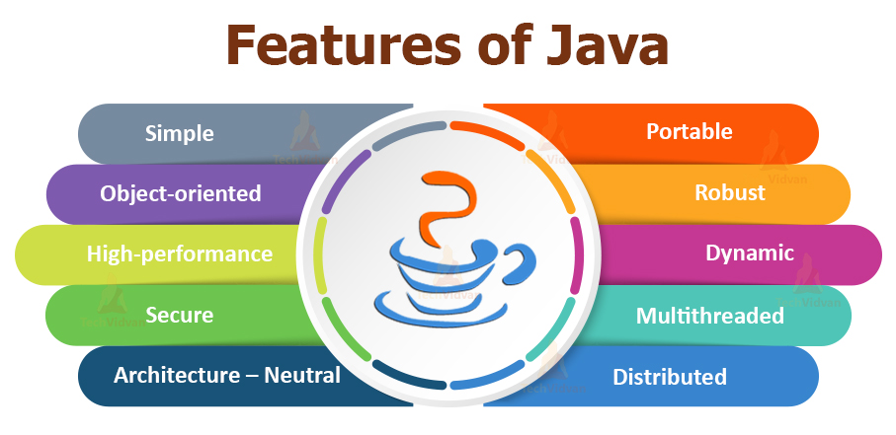

Slide 7
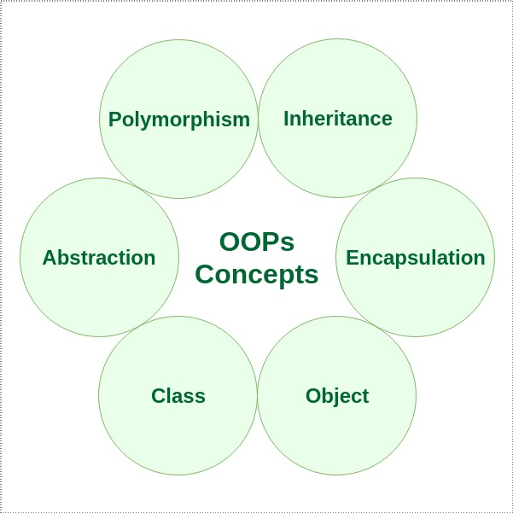
OOPs Concept

Slide 8
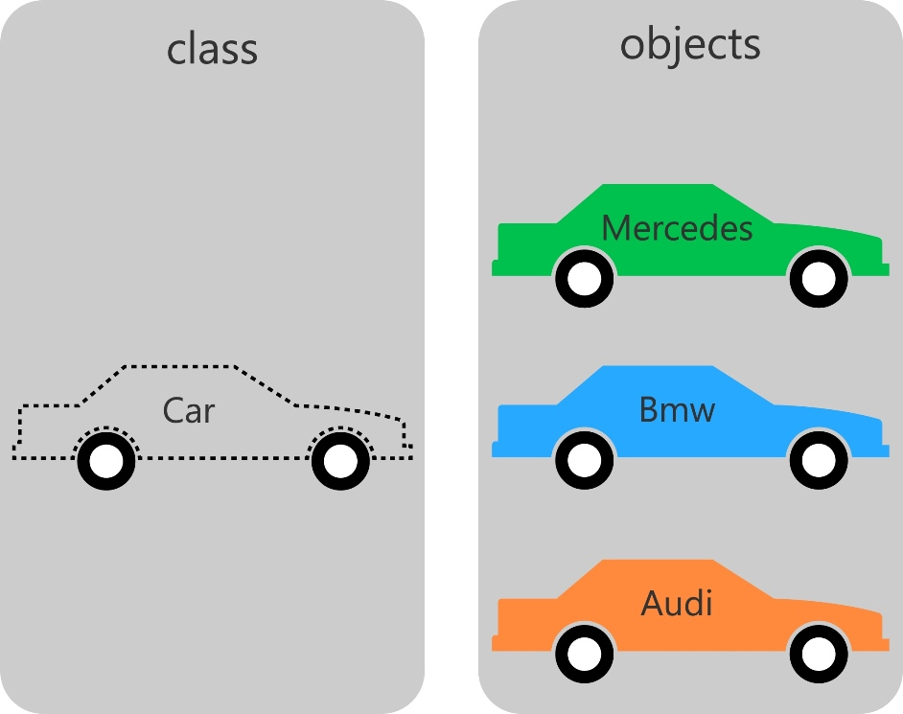
Class vs Object
Class is used as a template for declaring and creating the objects WHEREAS An object is an instance of a class.
The class has to be declared only once WHEREAS An object is created many times as per requirement.
A class is a logical entity WHEREAS An object is a physical entity.
Class Example: Bike WHEREAS Object Example : Ducati, Suzuki, Kawasaki.

Slide 9
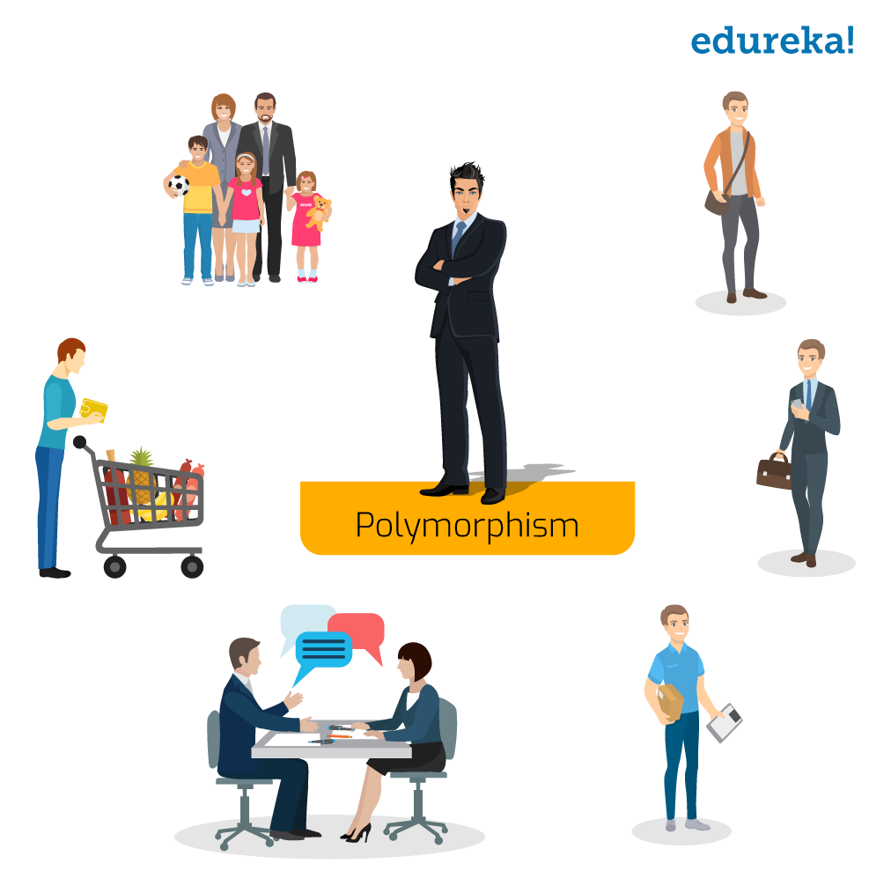
Polymorphism
Polymorphism in Java means, the same entity (function or object) behaves differently in different scenarios.

Slide 10
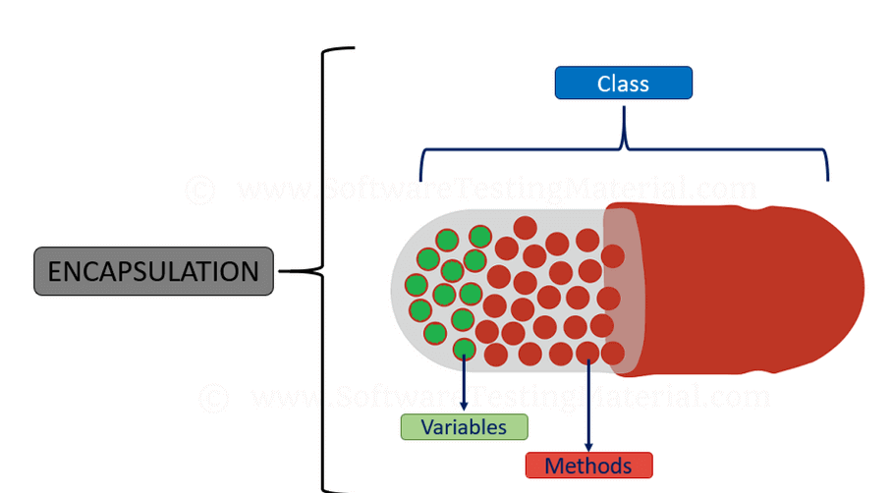
Encapsulation
Encapsulation is a process of combining data members and functions in a single unit called class.

Slide 11

Abstraction
In simple terms, abstraction “displays” only the relevant attributes of objects and “hides” the unnecessary details.

Slide 12
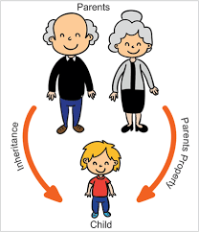
Inheritance
Inheritance is a process in which one object acquires all the properties and behaviors of its parent object automatically.

Slide 13
Project
The importance of placement system is increasing day by day. Thousands of applicants are depending placement cell. But the applicants are facing so many problems. This project is an attempt to minimize the problems of an applicant to find a correct job. If we can make it an online computerized and a mobile alert process it will be so fast and convenient for the applicants. Far from upsetting matters, however, new technologies have predominantly made life better and considerably easier for most 0people, and so it must be concluded that they should be welcomed.
Software does not require a dedicated computer and can be run on almost any PC running Windows OS The package includes the MOB JOBS software and a normal cell phone and data cable. It uses a normal SIM card from a GSM operator with a local mobile number. In functionality it is similar to the four digit short codes but unlike short codes that is billed according to the agreement between the content provider and the service provider and can only be reached from certain networks a long code (Local GSM number) can be accessed from almost anywhere in the world for the price of an Normal SMS depending on location and tariff of the Local GSM operator. Receiving the response is an incoming SMS and is free.

Slide 14
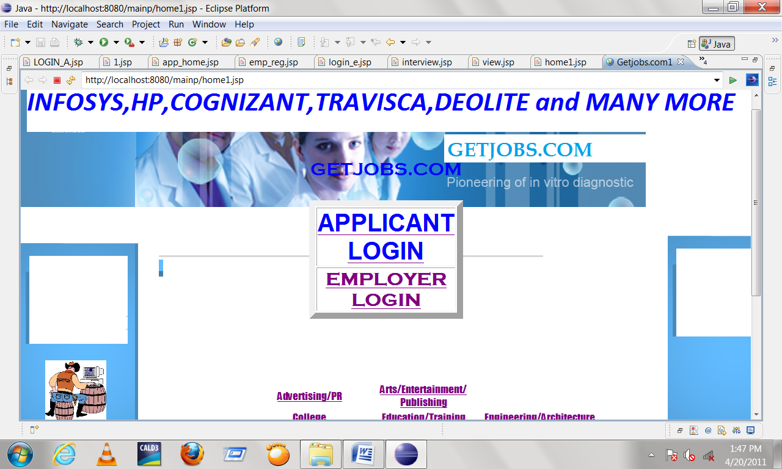
Home Page

Slide 15
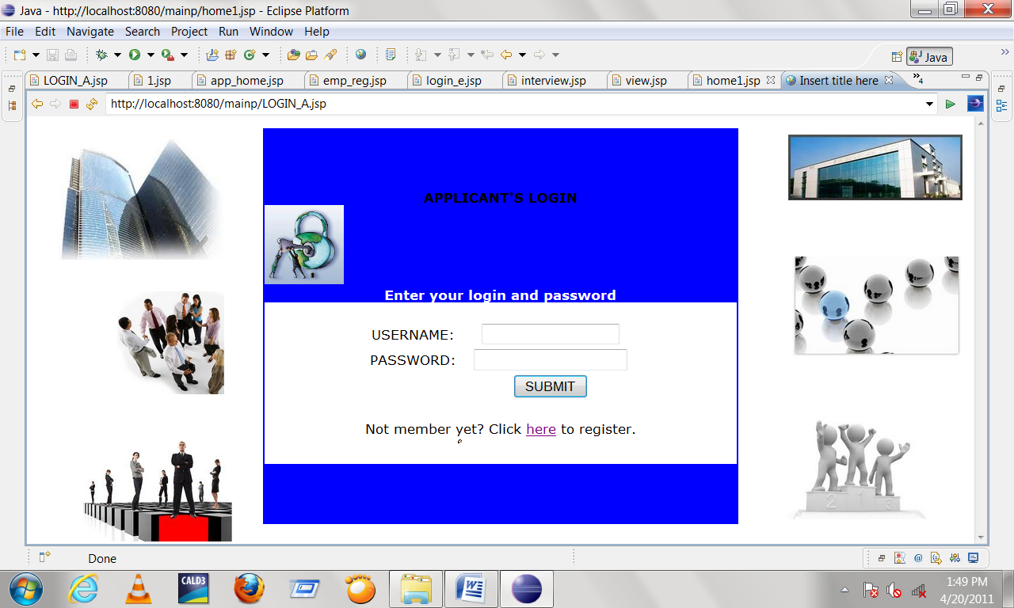
Login Page

Slide 16
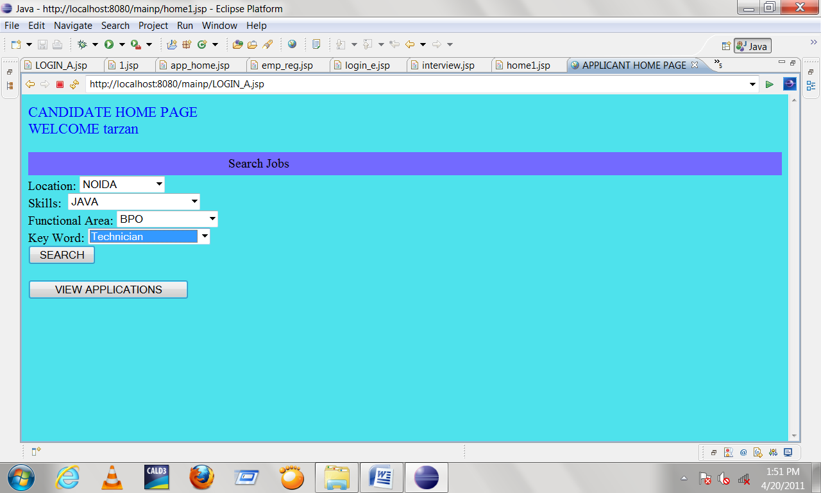
Job Search

Slide 17
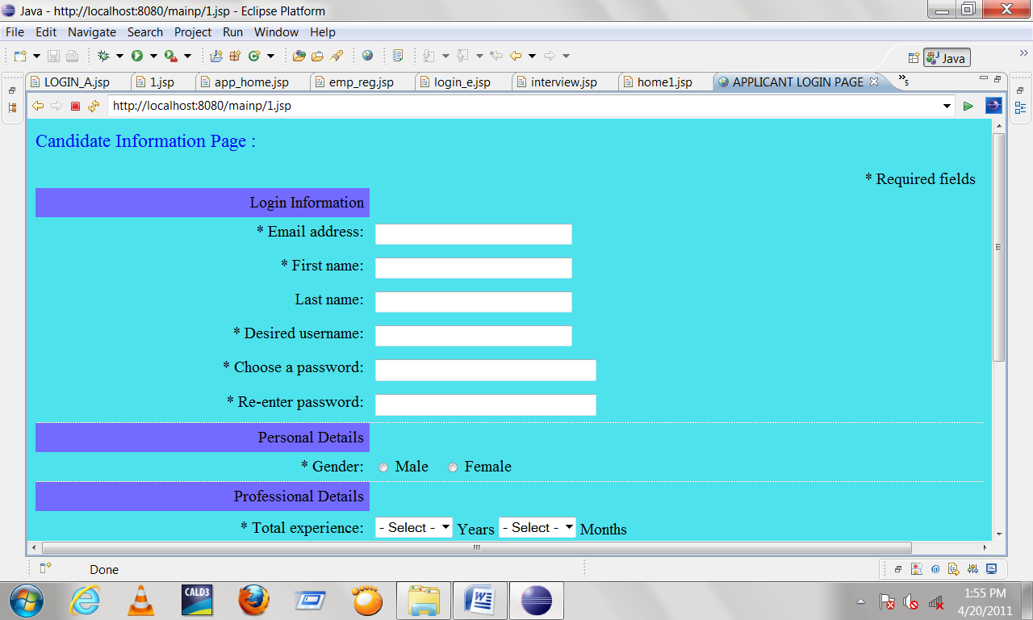
Candidate Registration

Slide 18
Certificate

Slide 19

Question?

